Slide 1
Introduction to RNA-seq and functional interpretation: Next steps in gene prioritisation
22nd Feb 2023

Slide 2
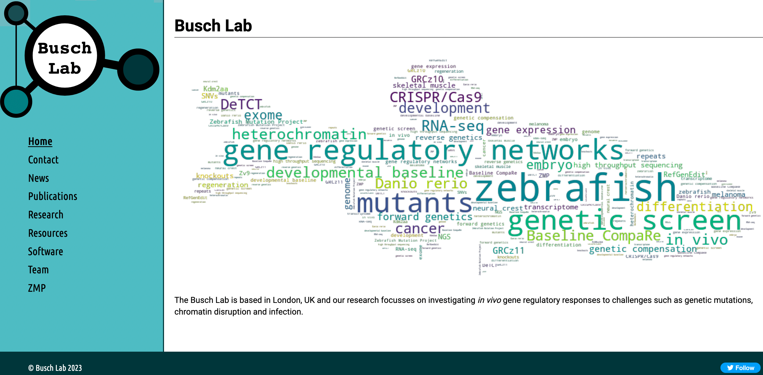
Me
Ian Sealy
Busch Lab, QMUL
Previously at Sanger Institute
RNA-seq / zebrafish
Run “Bioinformatics & Functional Genomics in Zebrafish” course at EBI

Slide 3
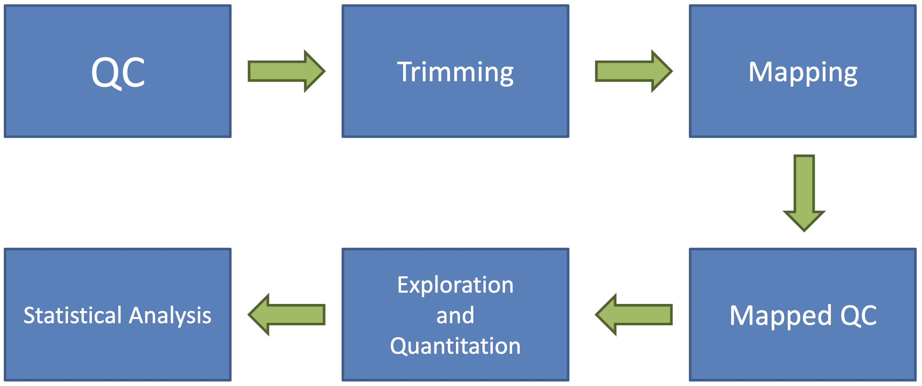
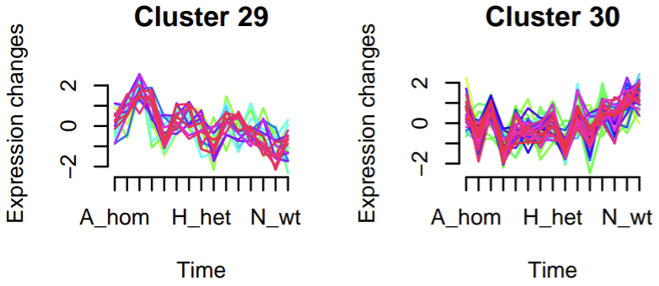
Gene list of interest
Starting point for today: gene list of interest
Most likely from RNA-seq differential expression analysis
But could be a list from any other analysis:
Clustering genes with similar expression profiles
Microarray analysis
Quantitative proteomics
Differential methylation analysis
etc…
From: Simon Andrews (yesterday)

Slide 4
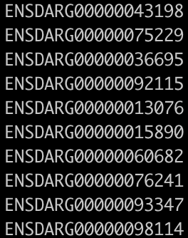
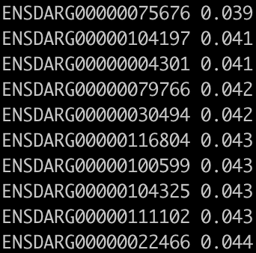
Unranked or ranked gene list?
Gene list can be:
Unranked (e.g. genes with somatic mutations in cancer sample)
Ranked (e.g. sensitivity in a CRISPR screen)
RNA-seq differential expression analysis produces ranked lists
Ranked lists are ordered by a score or metric:
e.g. adjusted p-value
e.g. log₂ fold change
Ranked lists can also have a threshold applied:
e.g. adjusted p-value < 0.05

Slide 5
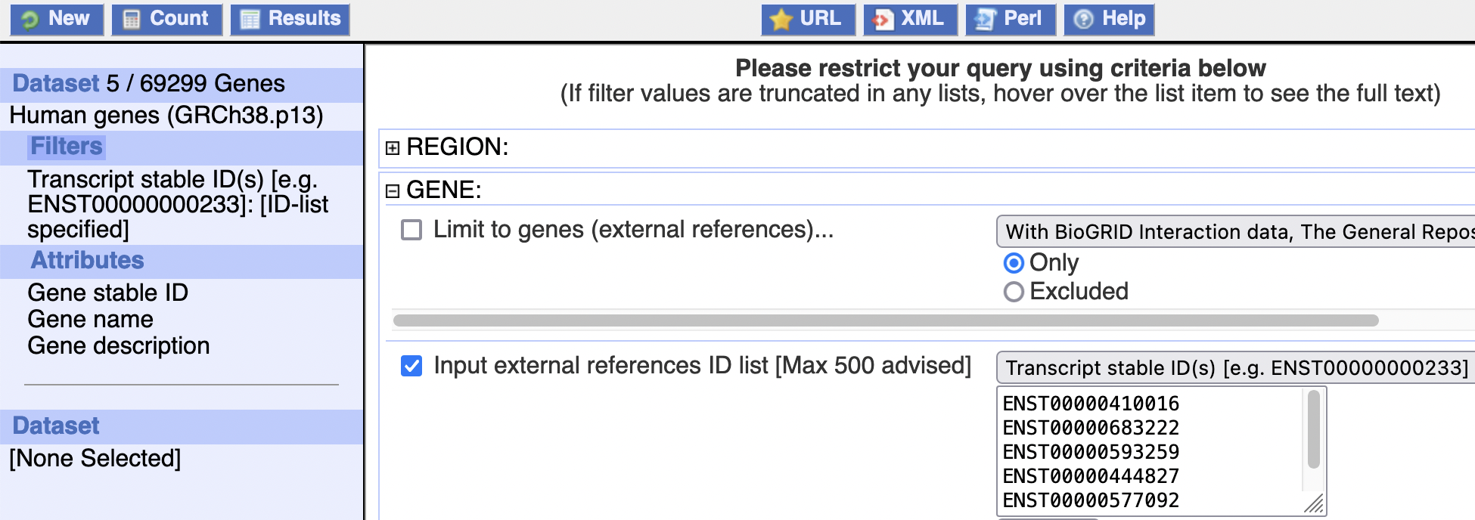
“Gene” list of interest
May not actually be a list of genes
Could be transcripts or proteins or SNPs, etc…
Most tools require a list of genes so need to convert
BioMart is a useful tool for conversions (and other bioinformatics tasks): www.ensembl.org/biomart/martview

Slide 6
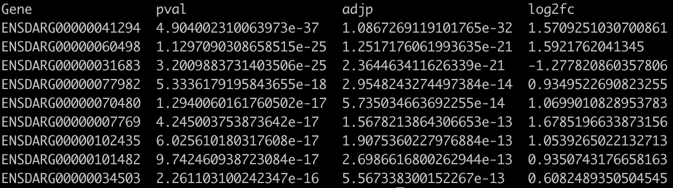
What next?
Have a gene list, but what do you do next?
How do you relate the gene list to existing knowledge?

Slide 7
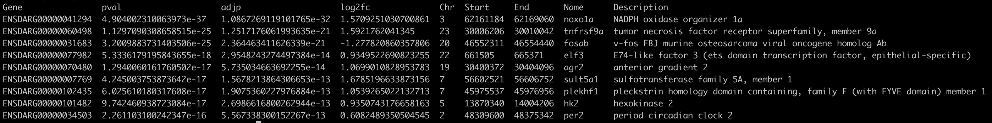
What next?
Have a gene list, but what do you do next?
How do you relate the gene list to existing knowledge?
Add annotation (e.g. BioMart)

Slide 8
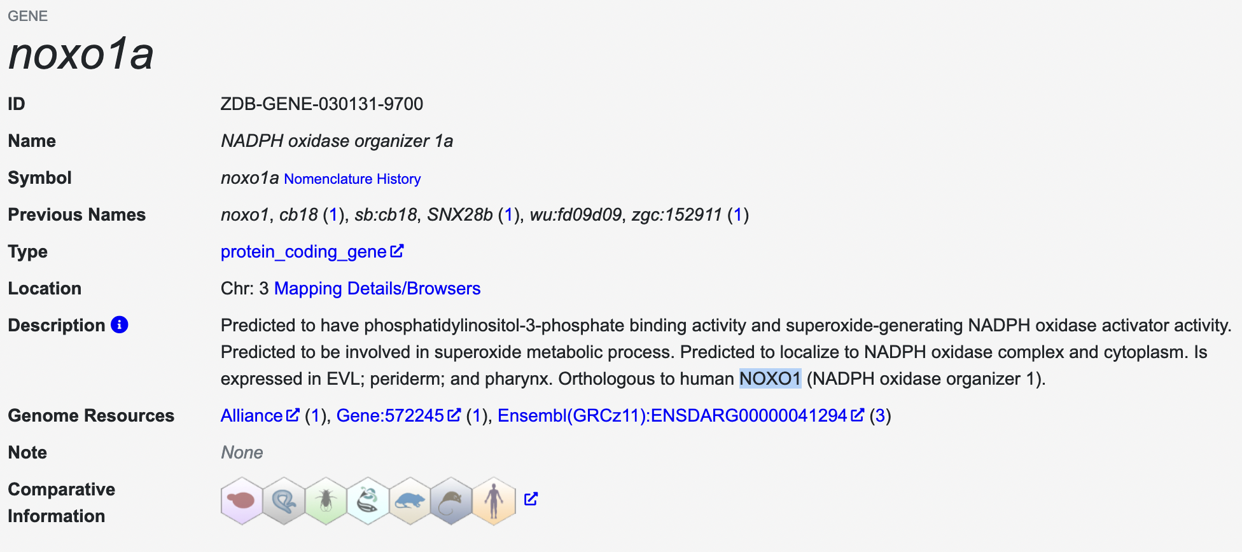
Look up genes in databases

Slide 9
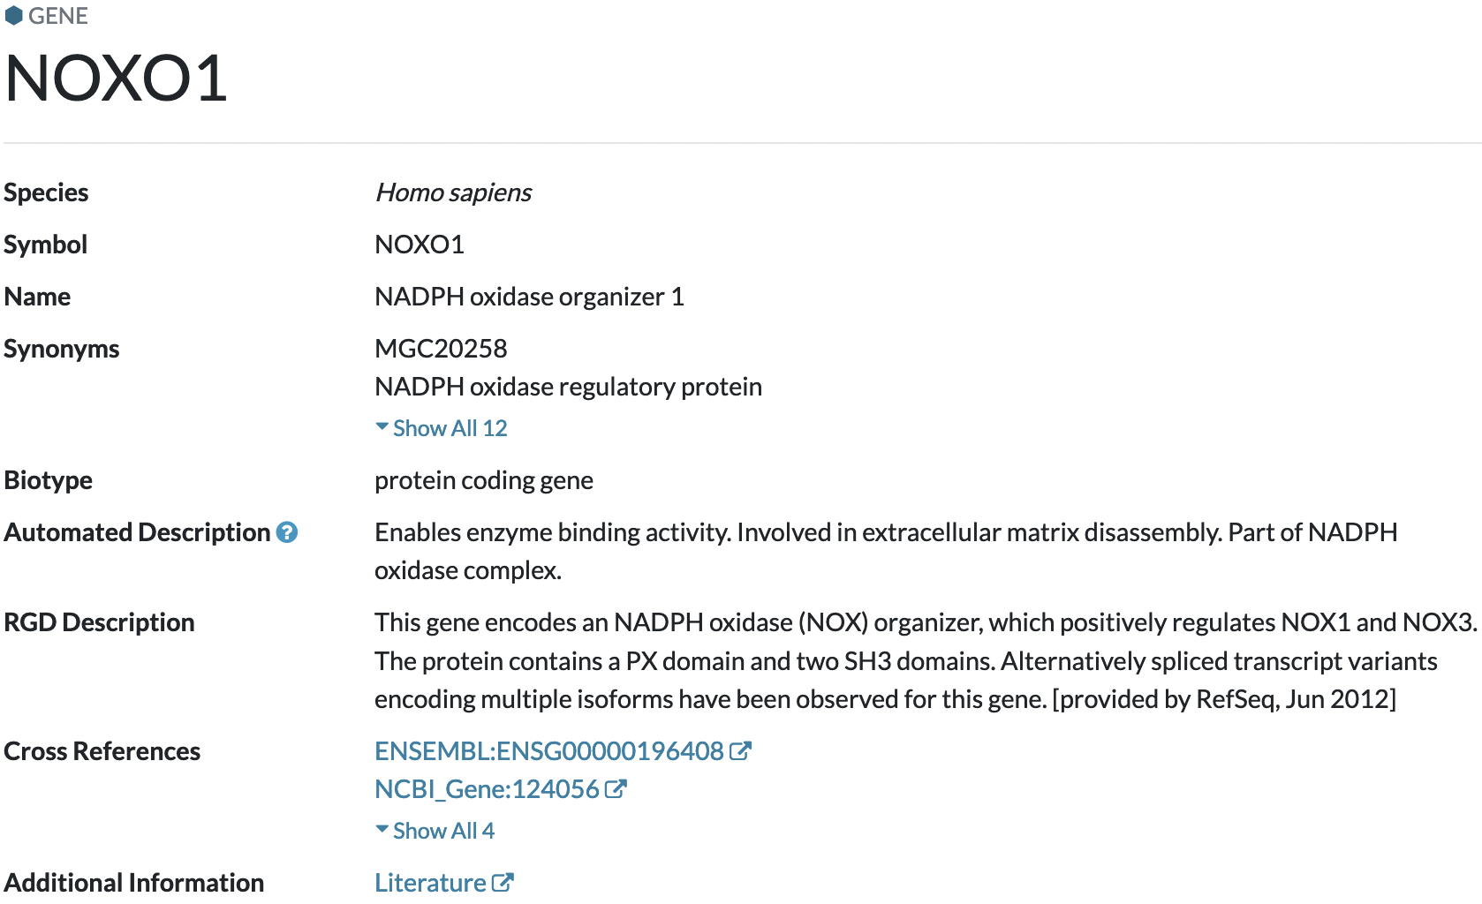
Look up genes in databases

Slide 10
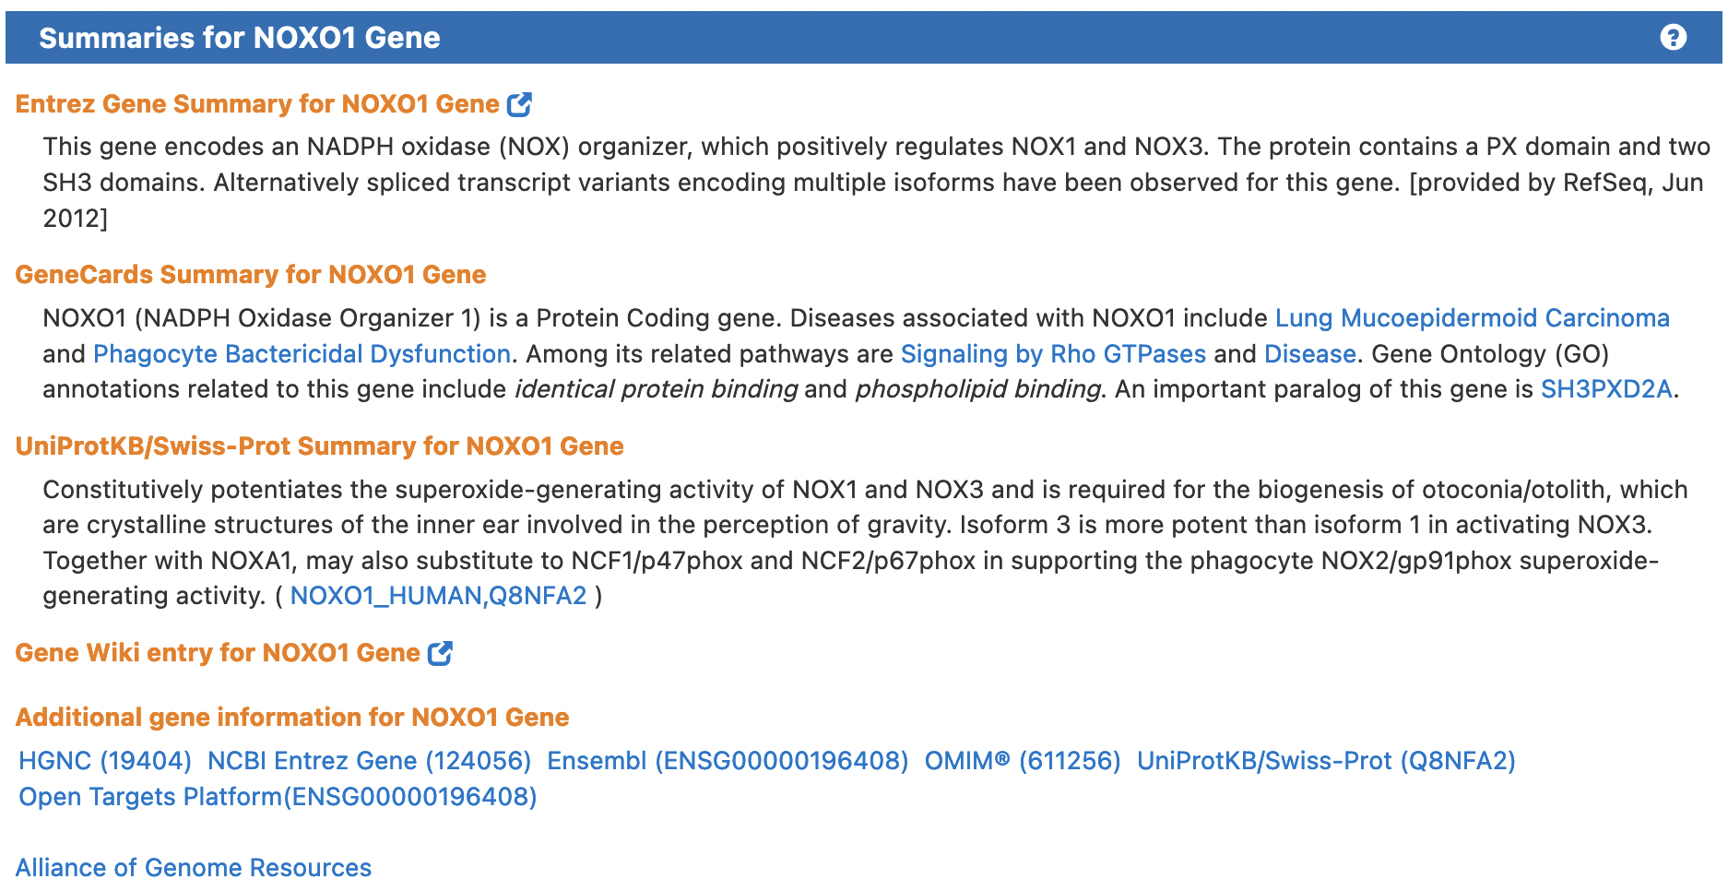
Look up genes in databases

Slide 11
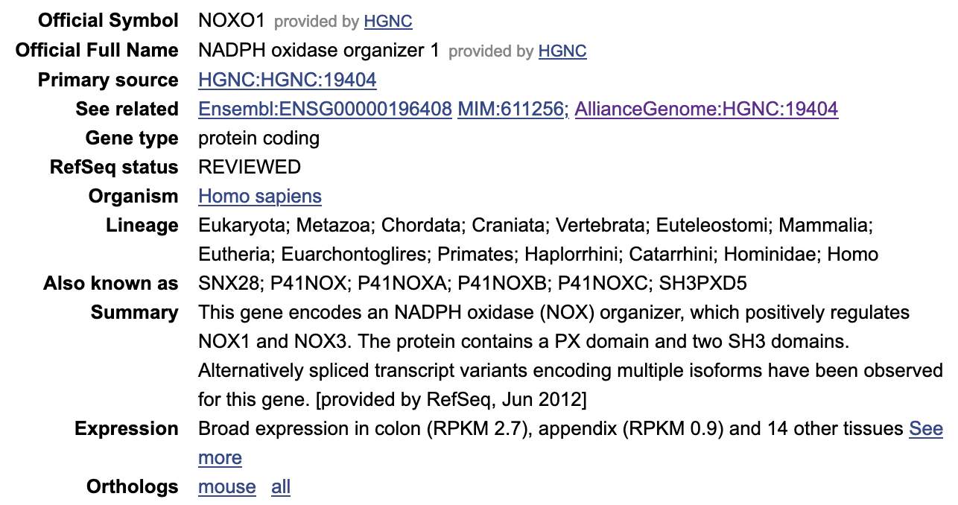
Look up genes in databases

Slide 12
Look up genes in databases
Manual literature review is OK for a handful of genes
But what if there are hundreds or thousands?
We need an automated process

Slide 13
Functional enrichment analysis
Functional enrichment analysis (or over-representation) systematically relates your data to existing knowledge
Can help you to:
Gain biological insight
Generate new hypotheses
Validate your experiment

Slide 14
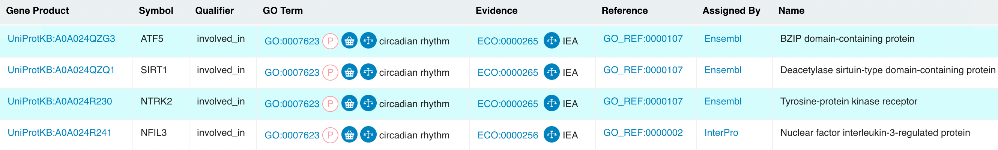
Functional gene sets
Existing knowledge is organised into functional gene sets in a standardised way, using data from previous experiments
A functional gene set is a group of genes with a common biological relationship (e.g. annotated to same biological process or involved in same pathway)
e.g. circadian rhythm:

Slide 15
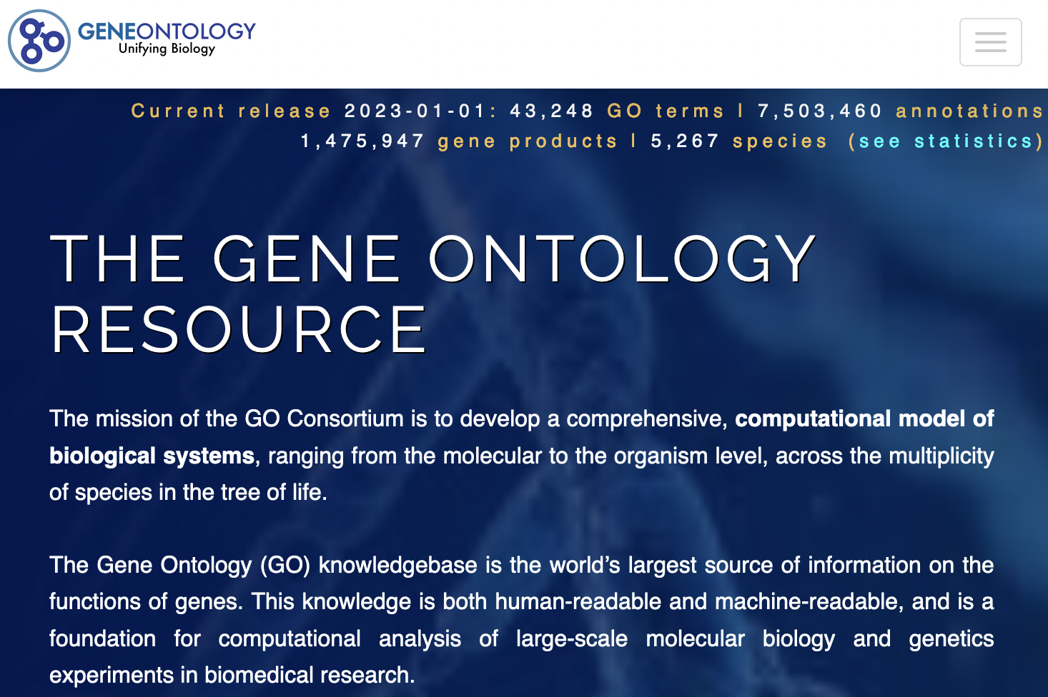
Functional annotation
Functional annotation is created and maintained by many dedicated databases and projects, e.g.
Gene Ontology (GO)
Reactome
KEGG
TRANSFAC

Slide 16
Gene Ontology
GO is largest source of gene functional annotation
Structured, controlled vocabulary of terms (and therefore gene sets)
Manually annotated by a large consortium
Data come from experimental and computational analyses

Slide 17
GO ontologies
Actually three separate ontologies:
Molecular Function – molecular level activities performed by gene products, e.g. transporter activity (broad) or Toll-like receptor binding (specific)
Cellular Component – the cellular location where a function is performed, e.g. ribosome
Biological Process – larger processes accomplished by multiple molecular activities, e.g. DNA repair (broad) or pyrimidine nucleobase biosynthetic process (specific)
Generally, in functional enrichment analysis, “biological process” is most useful

Slide 18
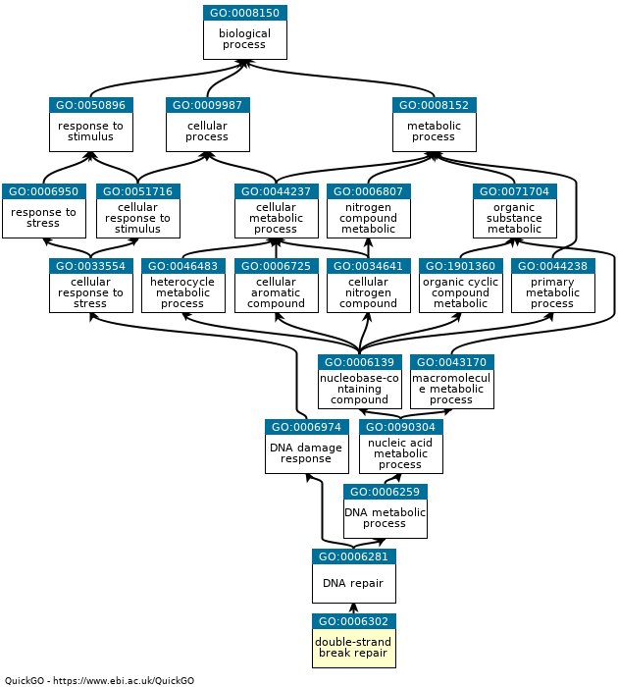
GO hierarchy
root term
more genes
broad terms
parent term
fewer genes
specific terms
child term

Slide 19
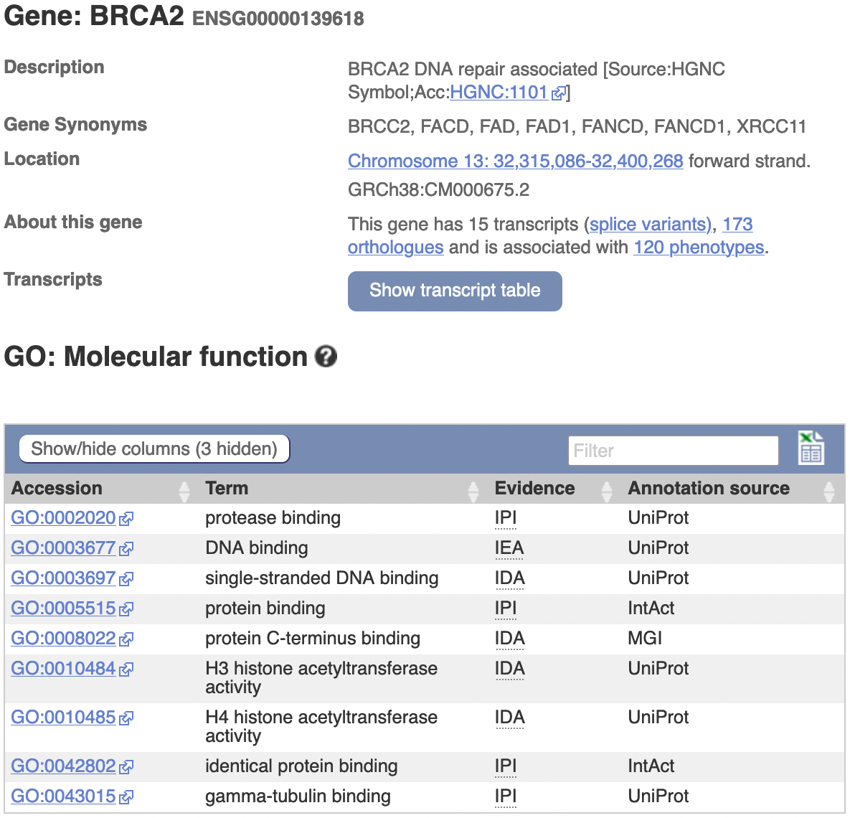
BRCA2 example

Slide 20
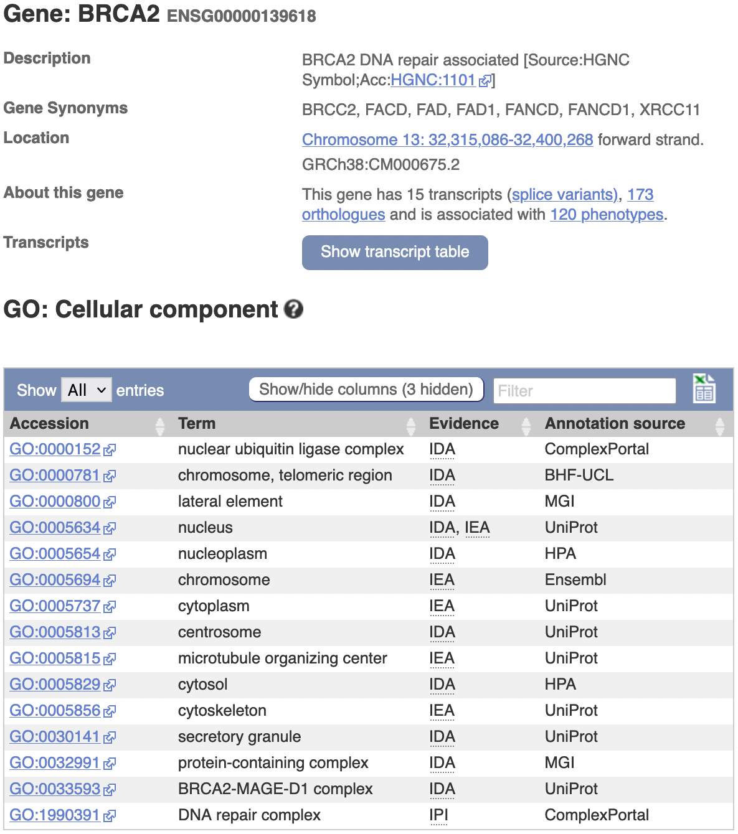
BRCA2 example

Slide 21
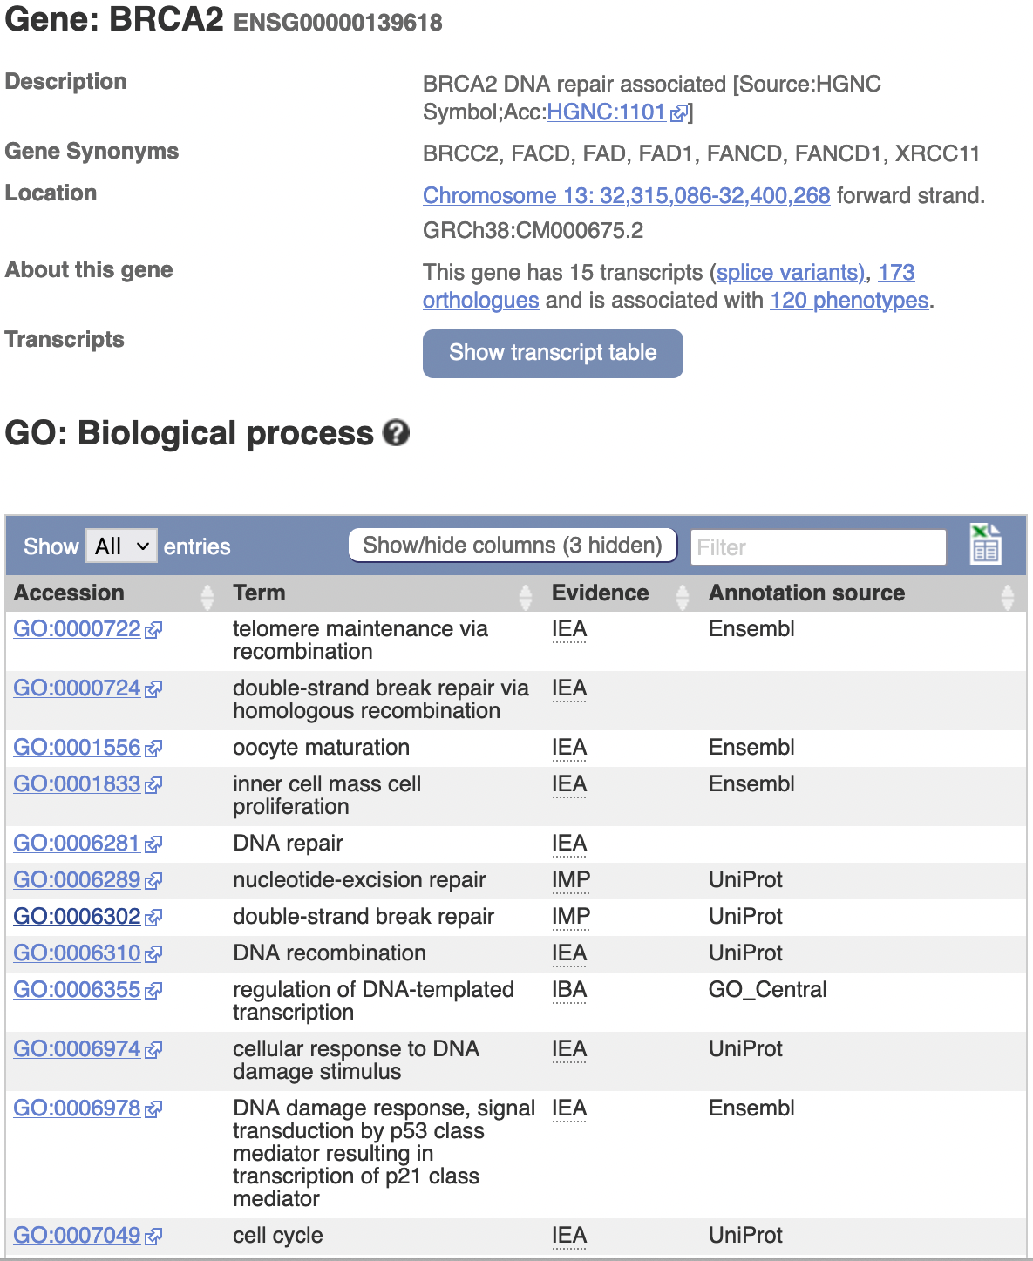
BRCA2 example

Slide 22
Functional enrichment analysis
How do we use all the existing annotation to interpret our gene list?
Want to identify biological functions that are enriched in our gene list

Slide 23
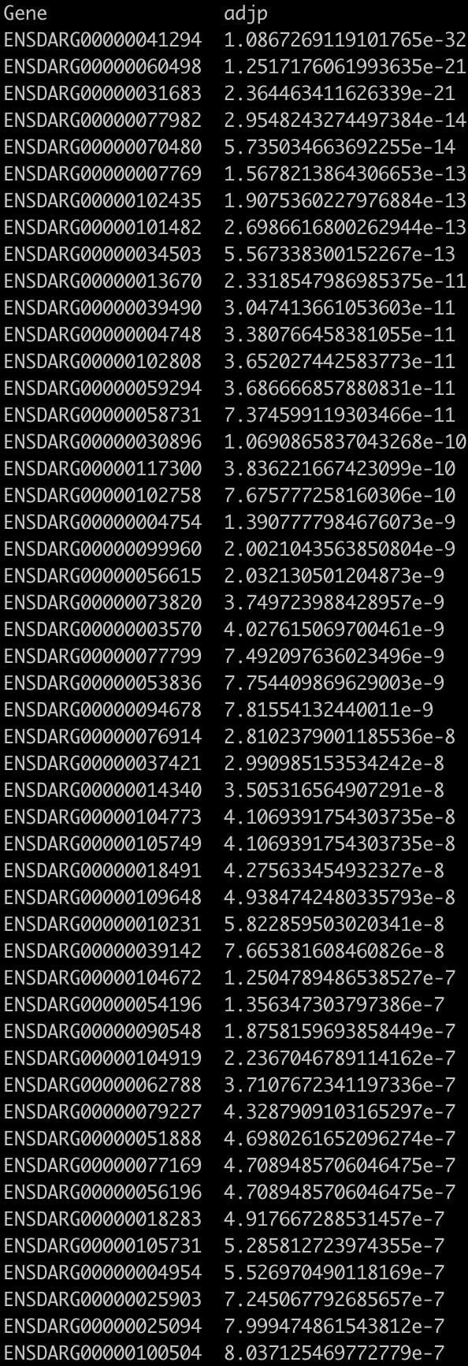
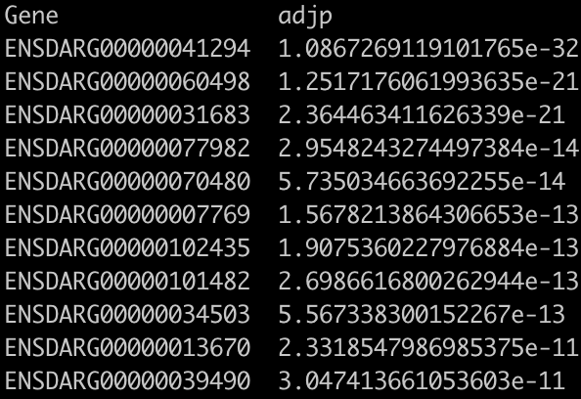
Testing for functional enrichment
20,000 genes assayed
500 significantly DE genes
Adjusted p-value < 0.05

Slide 24
Testing for functional enrichment
20,000 genes assayed
500 significantly DE genes
200 genes annotated to DNA repair
200/500 = 40%
(300 not annotated to DNA repair)
Adjusted p-value < 0.05
2000 genes annotated to function (e.g. DNA repair) 2000/20000 = 10%
(18,000 not annotated to DNA repair)

Slide 25
Testing for functional enrichment
20,000 genes assayed
500 significantly DE genes
200 genes annotated to DNA repair
200/500 = 40%
(300 not annotated to DNA repair)
Adjusted p-value < 0.05
Is seeing 200 DNA repair genes significantly differentially expressed more than we would expect by change?
2000 genes annotated to function (e.g. DNA repair) 2000/20000 = 10%
(18,000 not annotated to DNA repair)

Slide 26
Testing for functional enrichment
20,000 genes assayed
500 significantly DE genes
200 genes annotated to DNA repair
200/500 = 40%
(300 not annotated to DNA repair)
Adjusted p-value < 0.05
 | DE | Not DE | Total
Annotated to DNA repair | 200 | 1800 | 2000
Not annotated to DNA repair | 300 | 17700 | 18000
Total | 500 | 19500 | 20000
Is seeing 200 DNA repair genes significantly differentially expressed more than we would expect by change?
2000 genes annotated to function (e.g. DNA repair) 2000/20000 = 10%
(18,000 not annotated to DNA repair)

Slide 27
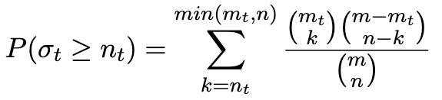
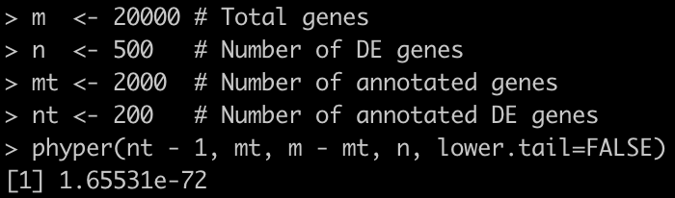
Hypergeometric test
 | DE | Not DE | Total
Annotated to DNA repair | 200 | 1800 | 2000
Not annotated to DNA repair | 300 | 17700 | 18000
Total | 500 | 19500 | 20000
Use the hypergeometric test to calculate the probability of having 200 or more DE annotated genes when 2000 of the 20,000 total genes are annotated

Slide 28
Multiple testing correction
In reality, won’t just be doing one test
Want to test all (or a lot) of the GO terms and other functional gene sets
Leads to problem of multiple testing
If you test 10,000 GO terms with a significance threshold of < 0.05 then you expect 500 terms to be significant simply by chance
Need to correct for multiple testing:
Bonferroni
Benjamini–Hochberg

Slide 29
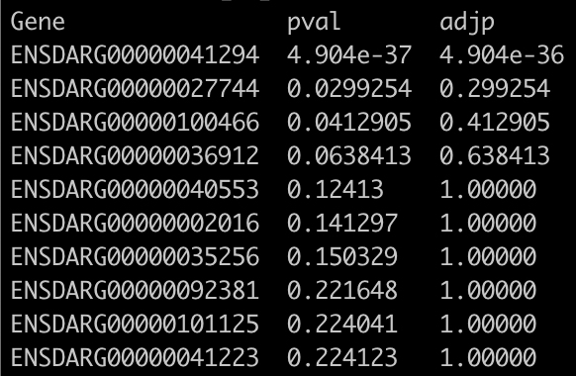
Bonferroni correction
Bonferroni is easiest to understand and most conservative
Simply multiply all p-values by the number of tests (i.e. functional gene sets)
Get adjusted p-values

Slide 30
Benjamini–Hochberg correction
Benjamini–Hochberg is less conservative and assumes that all tests are statistically independent
Not true – many functional gene sets overlap:
e.g. GO terms are hierarchical so a term’s annotations are a subset of their parental annotations
e.g. similar pathways can appear in KEGG and WikiPathways
e.g. some genes are co-expressed
Nevertheless, BH is widely and successfully used
Although Wijesooriya et al. (2022) found that 43% of papers surveyed failed to do multiple testing correction: doi.org/10.1371/journal.pcbi.1009935

Slide 31
Background gene set
Important to choose appropriate background gene set
Wijesooriya et al. (2022) found that only 4% of papers used an appropriate background (although most failed to specify what background was used): doi.org/10.1371/journal.pcbi.1009935
Best to choose all genes that could have been captured in your experiment
Examples:
All genes
All genes with non-zero total read count in DESeq2
All genes that pass DESeq2 independent filtering
All genes expressed in a particular tissue
All genes with annotations

Slide 32
Other methods
Functional enrichment analysis (or over-representation analysis) is just one method
Other methods and tests are available, e.g.
GSEA (gene set enrichment analysis)
Binomial test
Concentrating on functional enrichment analysis because most widely used and most tools available

Slide 33
Advantages of functional enrichment analysis
Improves statistical power as you effectively sum up counts from the multiple genes in a functional gene set
Improves statistical power as there are usually fewer functional annotations than genes, so less multiple testing correction is needed
Results are easier to interpret because they are familiar concepts like “DNA repair” rather than obscure gene names
Diverse data (e.g. RNA-seq, proteomics) can be integrated because they map to common terms/pathways
Results may be more comparable to related data because results are projected to a smaller set of functional annotations

Slide 34
Disadvantages of functional enrichment analysis
Terms or pathways with few genes are unlikely to ever be enriched
Hypergeometric test is more likely to identify larger functional gene sets (e.g. pathways with many genes) as significant
Genes with multiple functions can lead to enrichment of multiple terms/pathways, some of which aren’t relevant
Databases are (obviously) biased towards genes with annotation so unannotated genes (e.g. many non-coding RNA genes) are invisible to functional enrichment analysis

Slide 35
Recommendations based on disadvantages
For human RNA-seq data, consider excluding functional gene sets with < 10 genes and > 500 genes
Former are unlikely to ever be significant and latter are too likely to be significant and will often be better represented by other more specific terms/pathways
Always think about your own experiment:
e.g. is apoptosis enrichment expected or a symptom of a problem during sample preparation

Slide 36
Quiz!
Quiz on Mentimeter (www.menti.com)

Slide 37

Functional enrichment tools
Many, many functional enrichment analysis tools exist
Many are created, published and then never updated
Best to choose a well used tool
Using g:Profiler because:
Consistently and regularly updated over many years
Easy to use
Free
Well documented
Has advanced features, like simultaneous analysis of multiple lists
Has web interface but also an API with supported R and Python packages
Covers over 800 species/strains

Slide 38

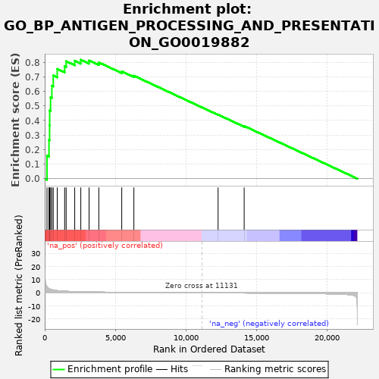
Other functional enrichment tools
Other tools are available (and good):
Enrichr (maayanlab.cloud/Enrichr/):
Web-based
Similar to g:Profiler
Only human, mouse, fly, yeast, worm and zebrafish
GSEA (www.gsea-msigdb.org/gsea/):
Desktop software
Implements GSEA method
Works on whole genome ranked gene lists
Looks for gene sets enriched at top or bottom of your ranked list
p-values computed by permutating ranked lists

Slide 39
g:Profiler
g:Profiler uses Ensembl as its primary data source (specifically, BioMart)
Tracks Ensembl release schedule (every three or four months) but with delay of weeks or months
g:Profiler beta covering Ensembl 108 (released in October) came out yesterday, but Ensembl 109 came out two weeks ago
Recommend using Ensembl IDs as input, but not essential

Slide 40
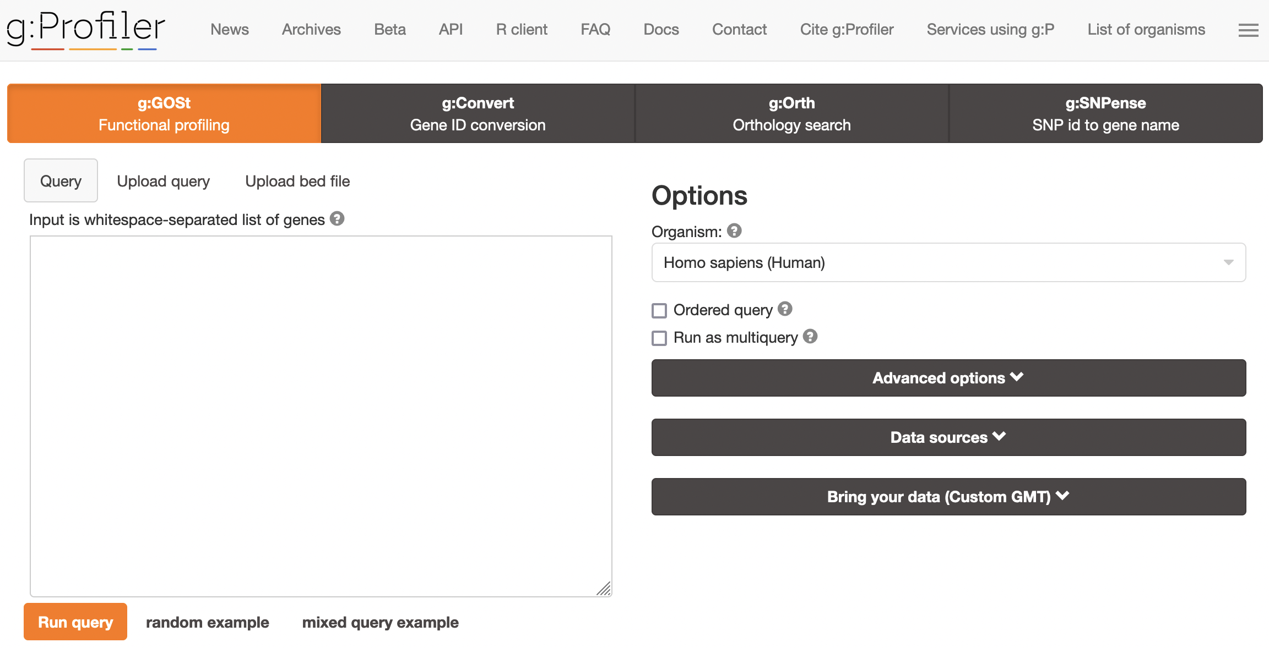
g:Profiler

Slide 41
g:Profiler – four tools

Slide 42
g:Profiler – gene list
105 identifiers recognised for human
82 for mouse; 92 for zebrafish

Slide 43
g:Profiler – options
821 species/strains in current release
(849 in next release/beta)

Slide 44
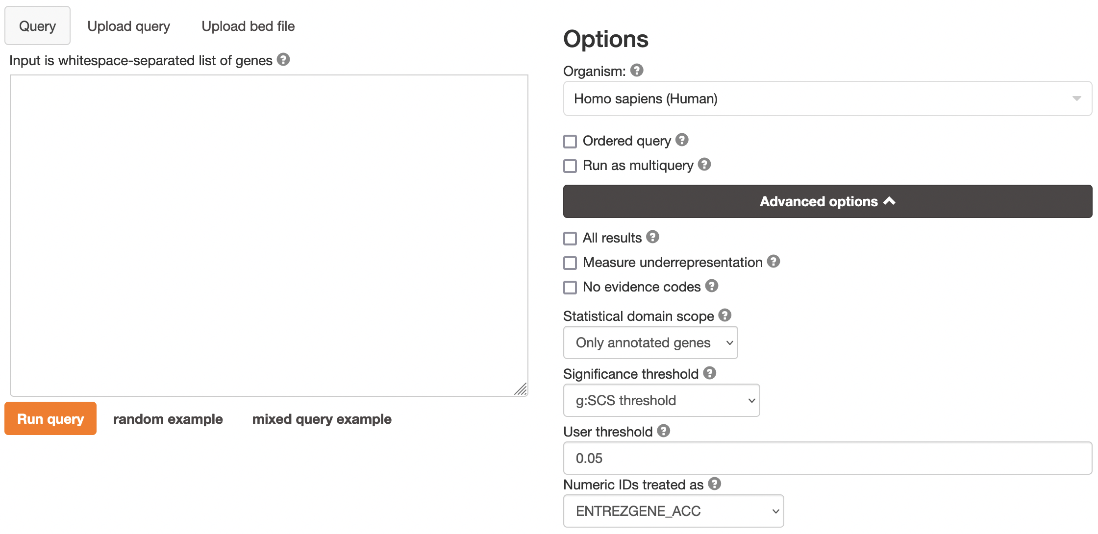
g:Profiler – advanced options
g:SCS – “Set Counts and Sizes”
Accounts for hierarchical nature of GO
Less conservative than Bonferroni but more conservative than Benjamini-Hochberg

Slide 45
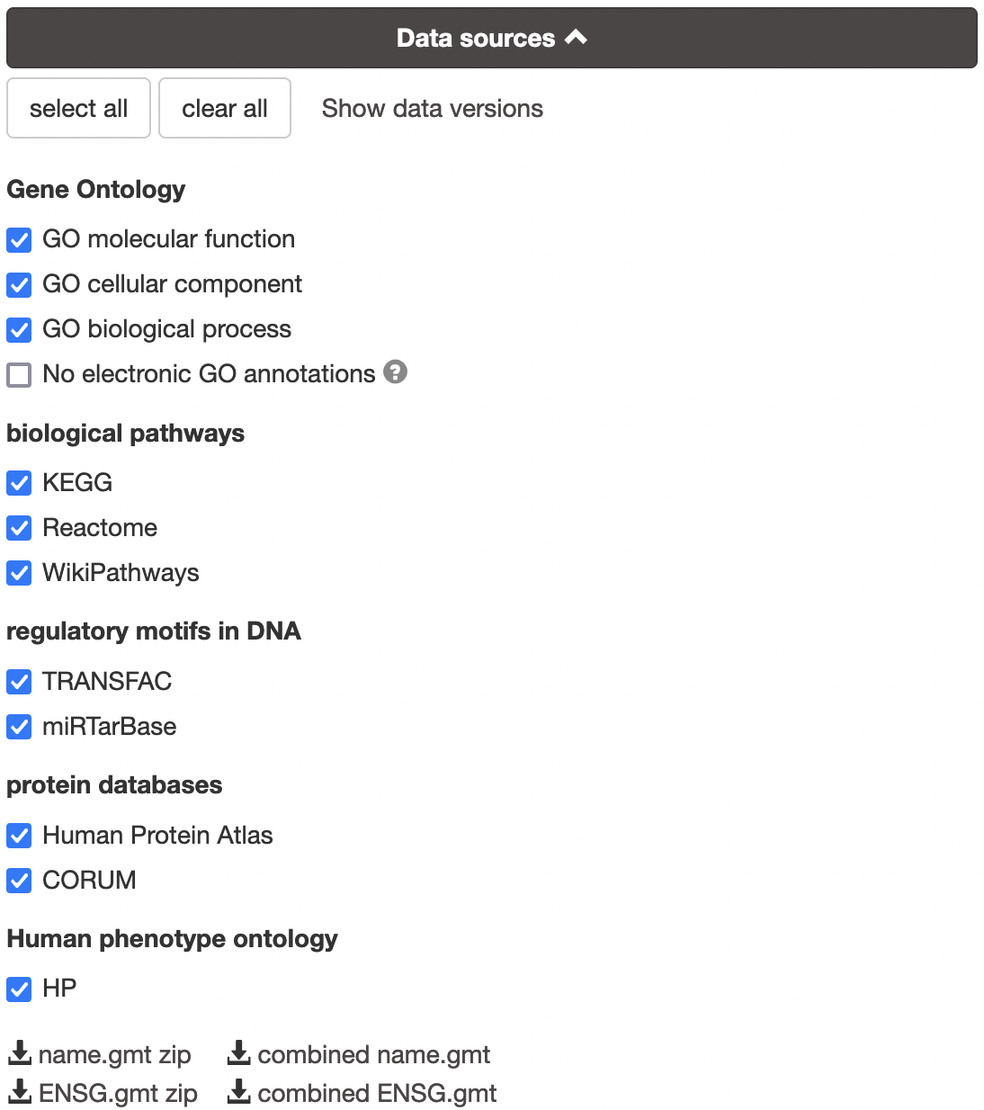
g:Profiler – data sources
Can exclude GO IEA evidence term (inferred from electronic annotation)
But often as reliable as human annotation (Škunca et al. 2012)
Suggest running with and without if using human or model organisms
9 data sources
(or 11 if count GO as three separate sources)
All 9 not available for all species

Slide 46
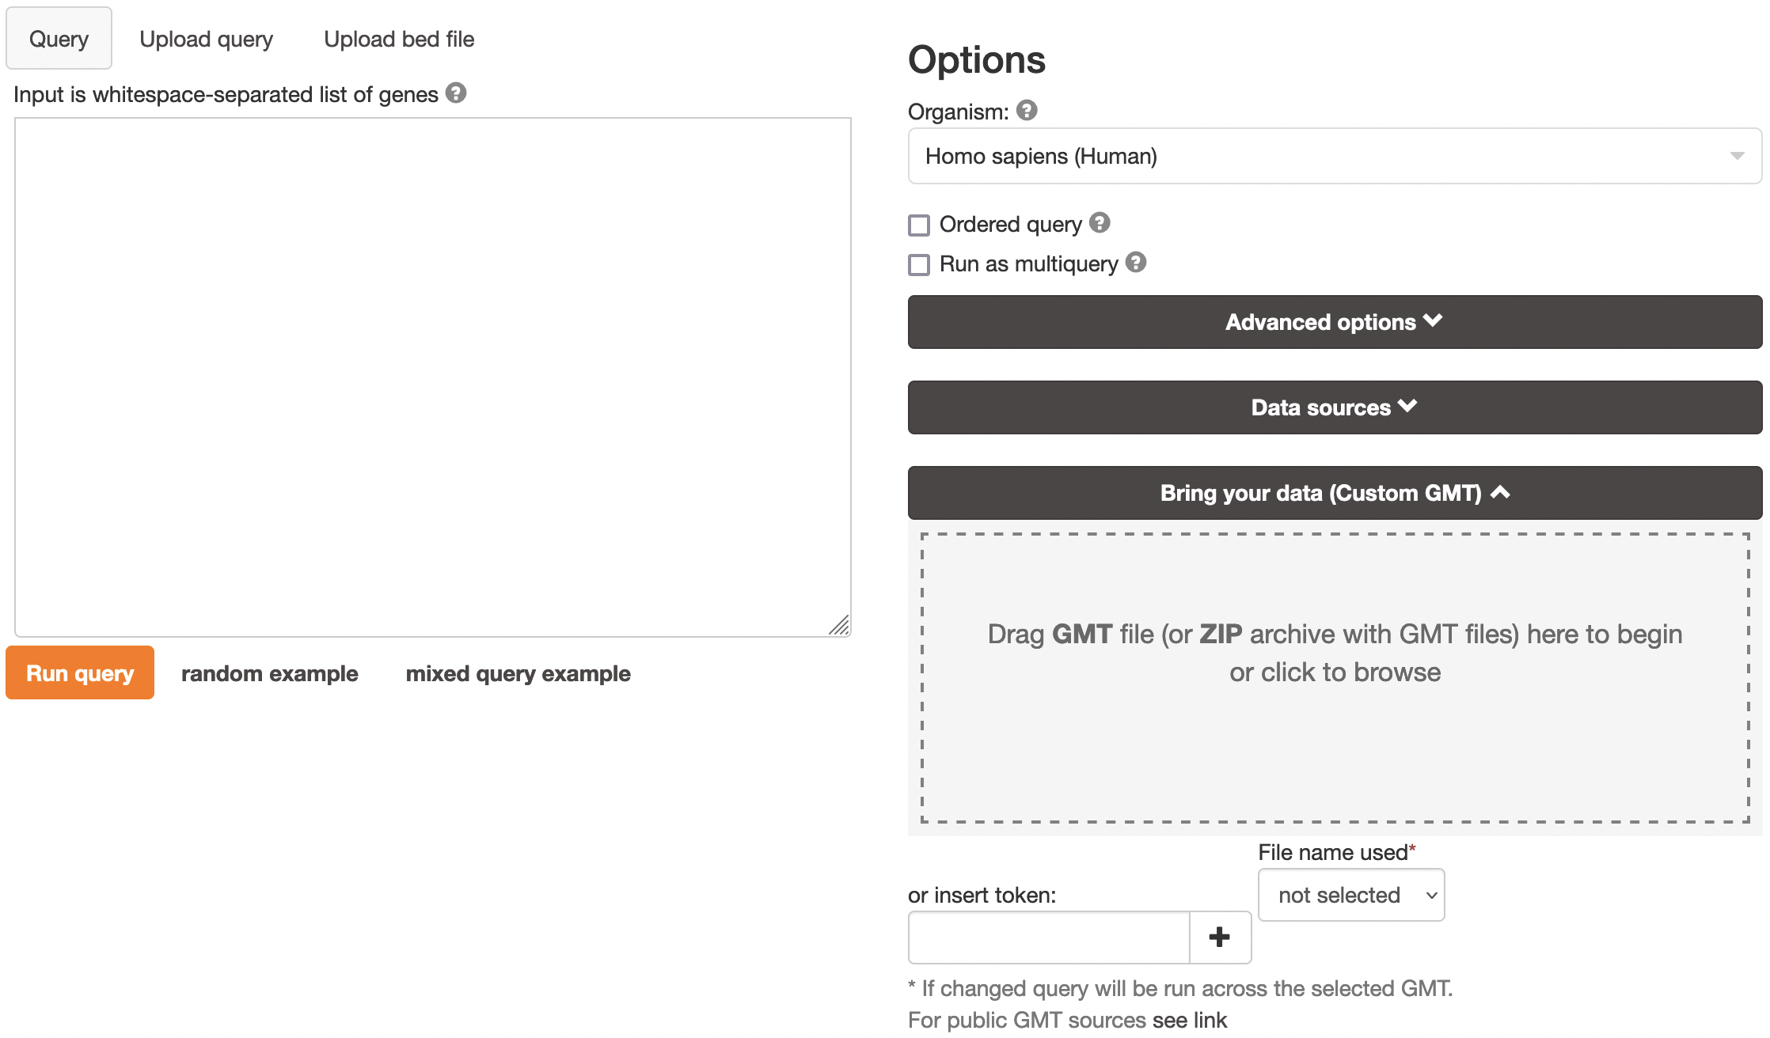
g:Profiler – bring your data

Slide 47
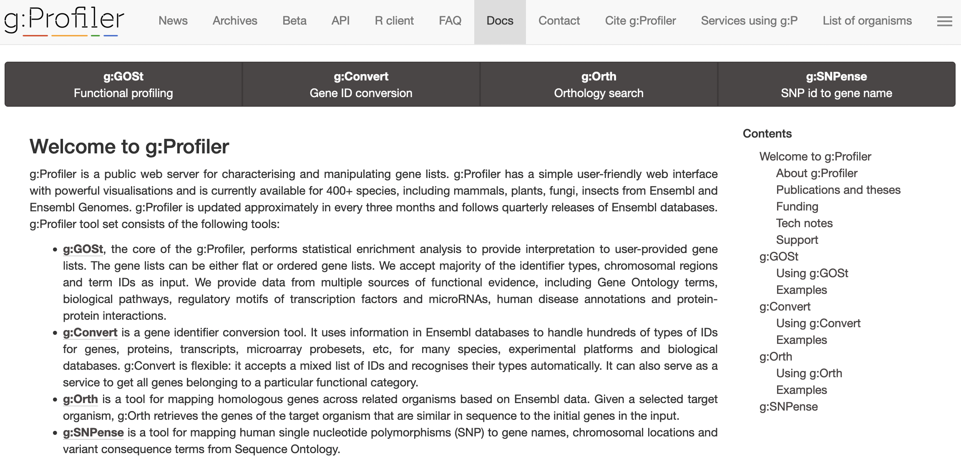
g:Profiler – documentation

Slide 48
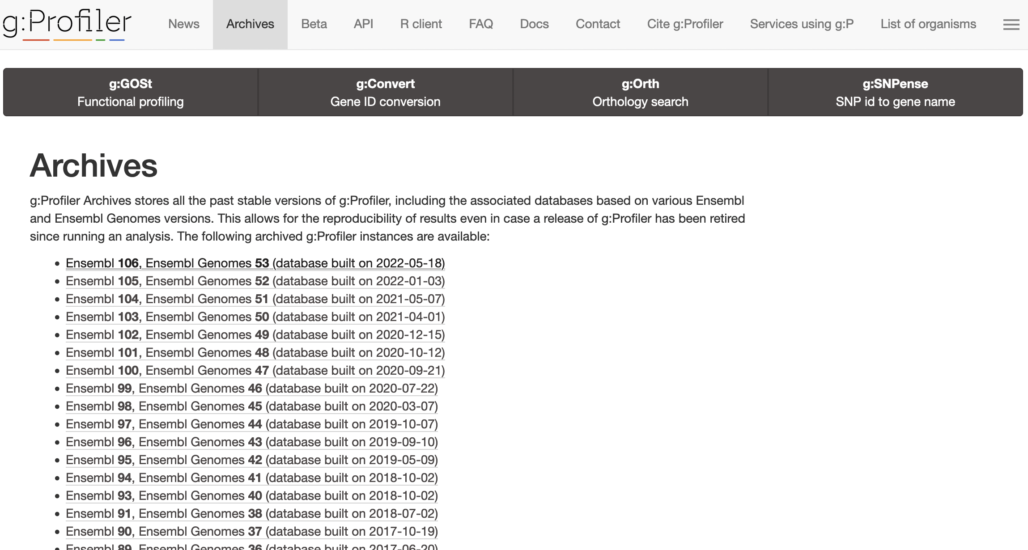
g:Profiler – archives

Slide 49
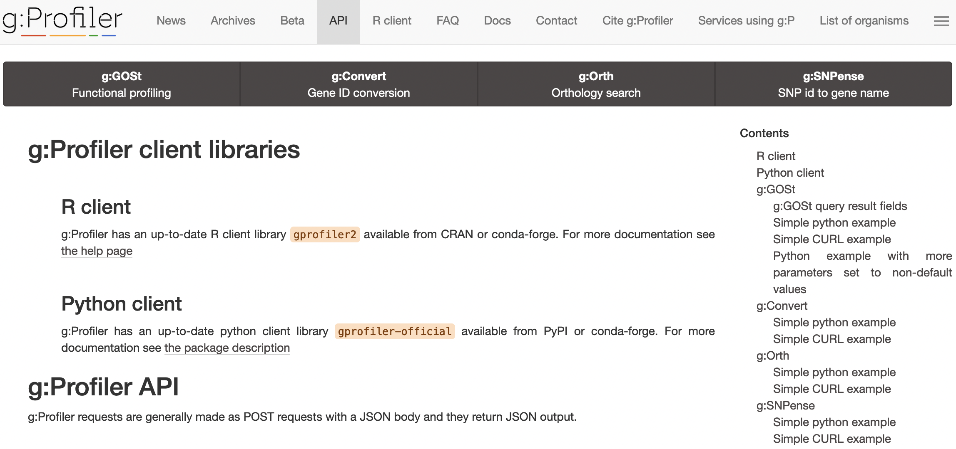
g:Profiler – API and libraries

Slide 50
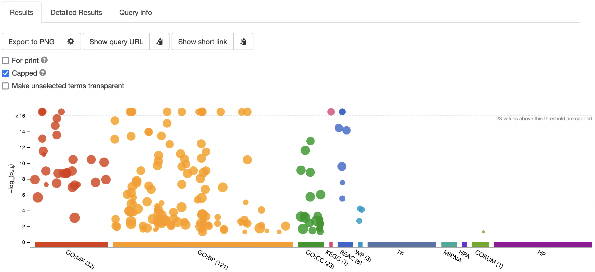
g:Profiler – results

Slide 51
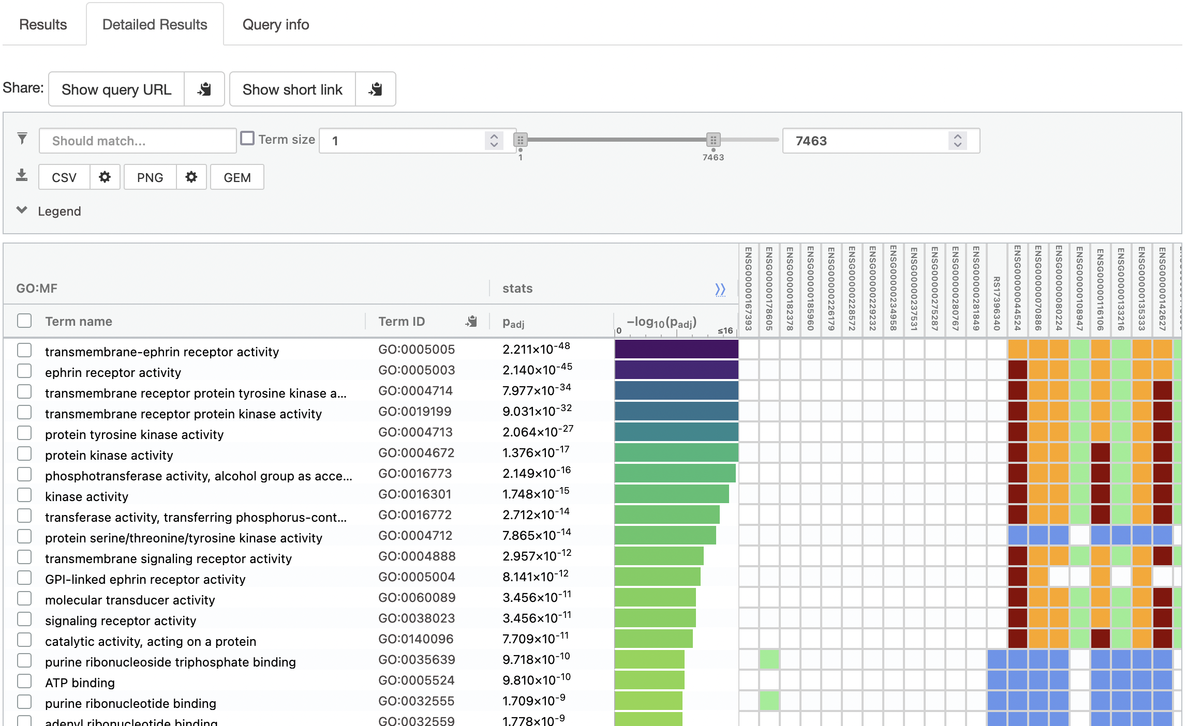
g:Profiler – detailed results

Slide 52
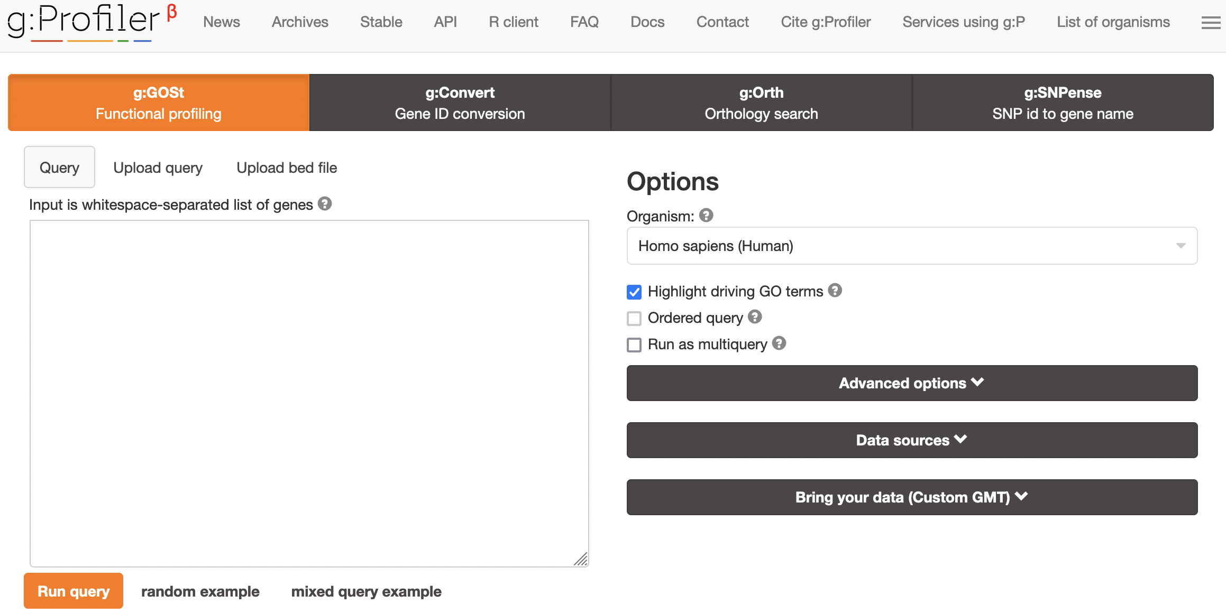
g:Profiler – beta

Slide 53
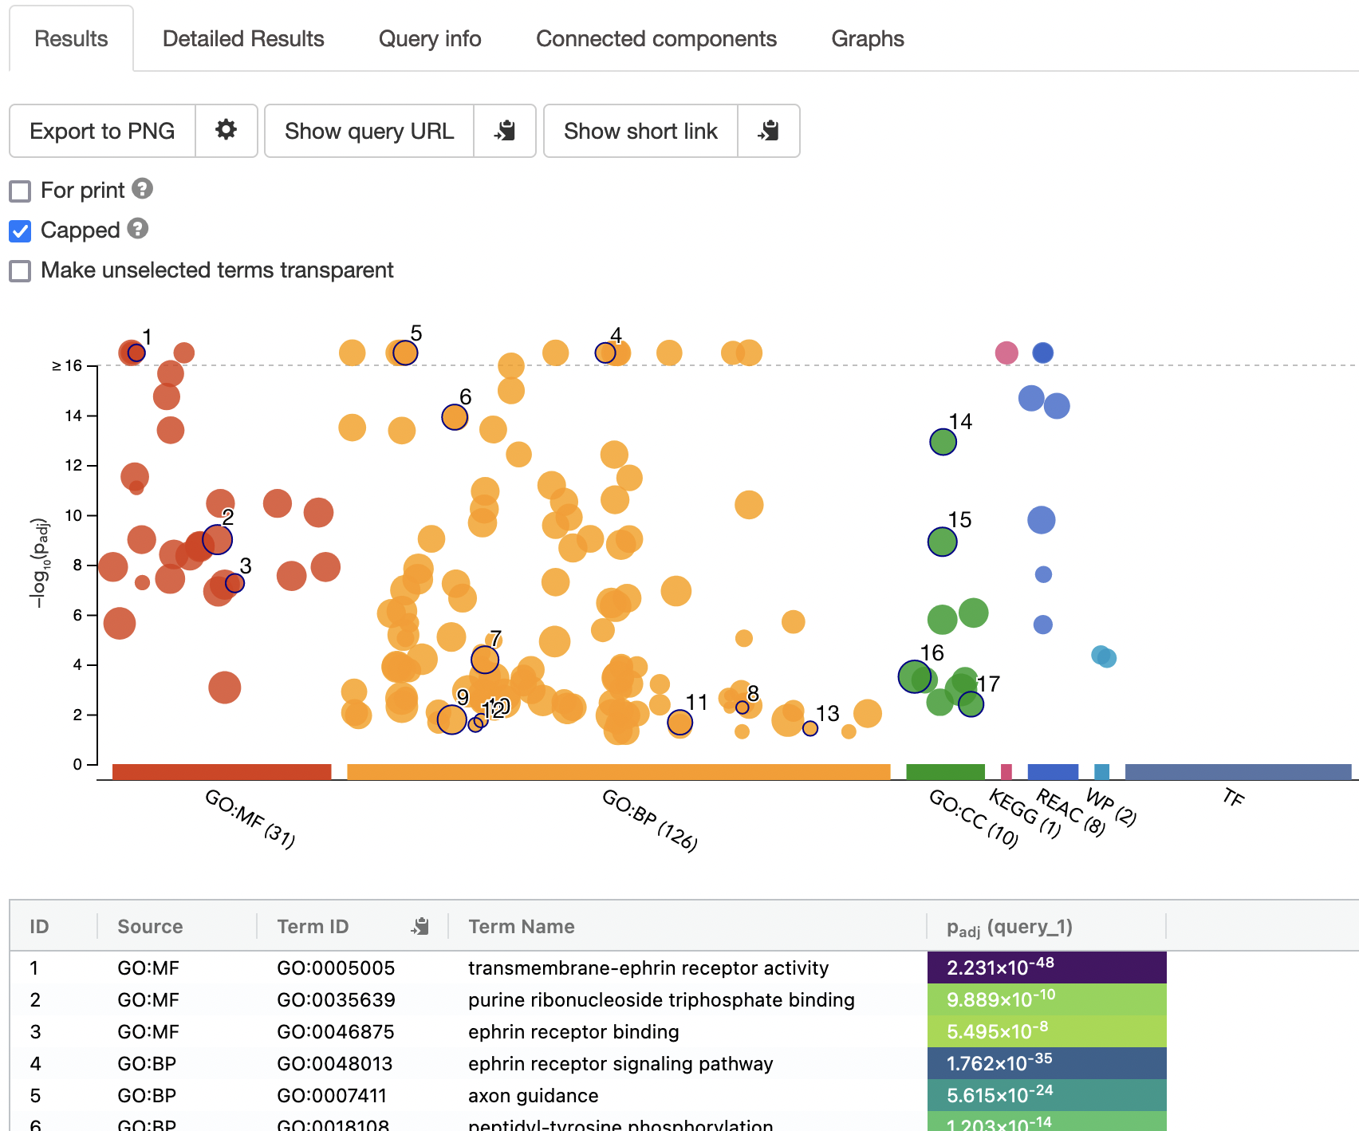
g:Profiler – beta results

Slide 54
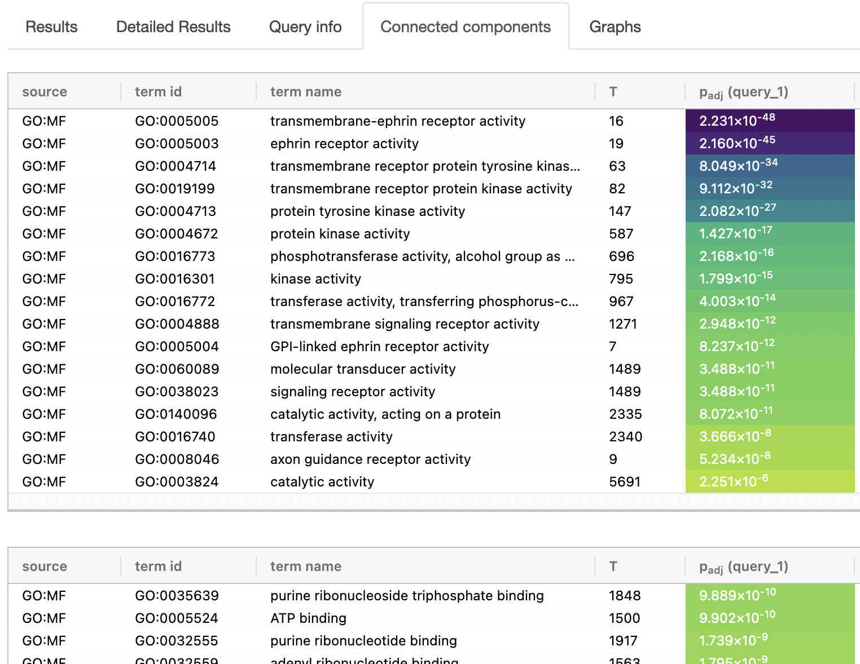
g:Profiler – beta connected components

Slide 55
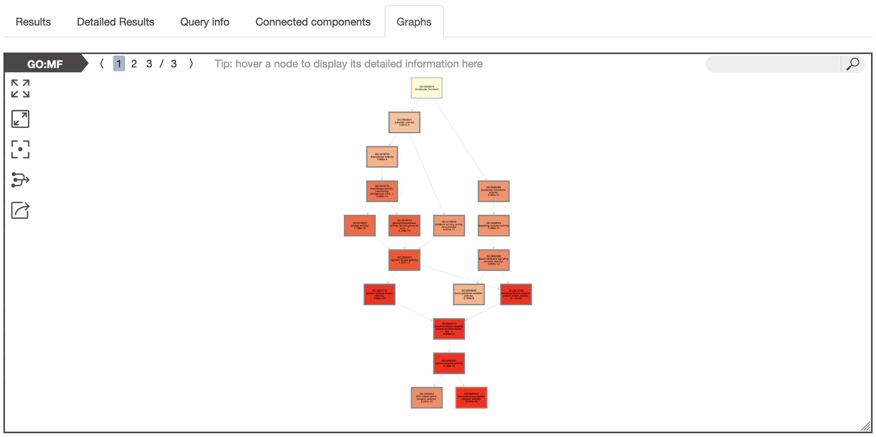
g:Profiler – beta graphs

Slide 56
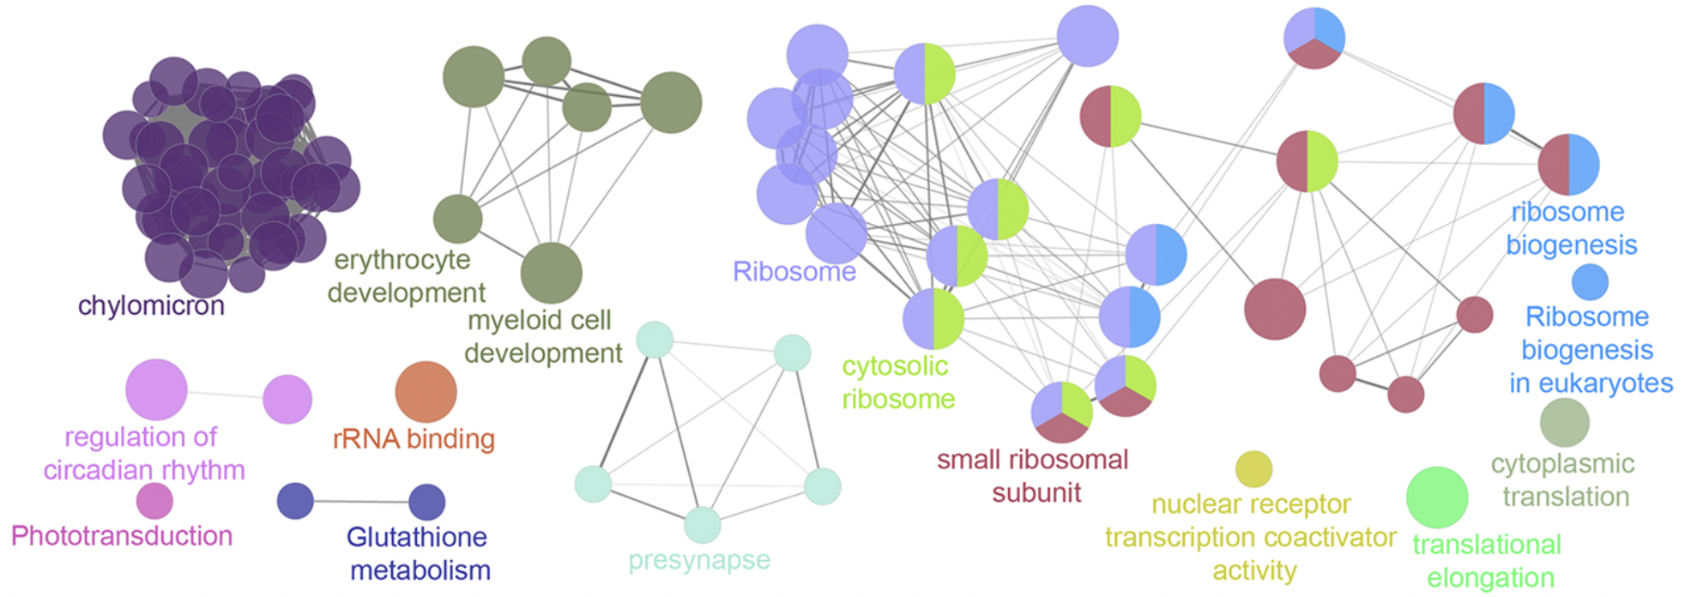
Summarising functional enrichment
Functional enrichment analysis (hopefully) summarises a gene list into something shorter and more comprehensible
But what if the list of functional enrichments is also long and/or repetitive?
The connected components functionality is an attempt to solve that problem
Other methods:
Cytoscape / EnrichmentMap
Cytoscape / ClueGO

Slide 57
g:Profiler live demo!
biit.cs.ut.ee/gprofiler/

Slide 58
Exercises (plus data and slides)
Exercises are available from: rnaseq2023.buschlab.org
Plus data for exercises and these slides
Everything also available on penelopeprime

